Slide 1

Vehicle Parking Management System: A Simple Guide
Hey there! Let's explore how a basic parking system works, like one we coded for our project.

Slide 2
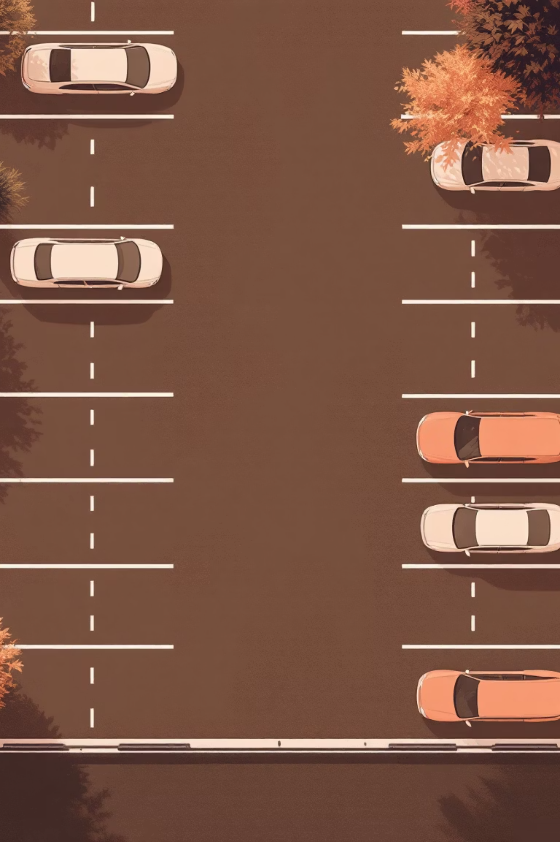

What is a Parking Management System?
Manages Parking Spaces
Tracks Slots
Knows which spots are free or taken.
Keeps track of where vehicles are.
Calculates Charges
Figures out parking fees automatically.

Slide 3

Key Components of Our Program
Vehicle Details
Parking Slots
Number plate
Total 20 slots
Vehicle type (car, bike, truck)
Always checking for empty ones!
Hours parked

Slide 4

How Charges Are Calculated
Our system uses simple rates:
Car
₹20 per hour
Bike
₹10 per hour
Truck
₹30 per hour
Other
₹15 per hour
Imagine: A car for 3 hours = ₹20 × 3 = ₹60!

Slide 5

Showing Available Slots
Our program is super helpful in finding a spot:
It scans all 20 parking slots.
Then, it tells you exactly which slots are free.
No more circling around, looking for parking!

Slide 6
Parking a Vehicle: Step-by-Step
01
02
03
Find a Slot
Get Details
Calculate Cost
Looks for the first empty parking spot.
Asks for vehicle number, type, and how many hours.
Figures out the parking charge instantly.
04
05
Assign Spot
Confirm
Puts the vehicle into that empty slot.
Shows where it's parked and the charge.

Slide 7
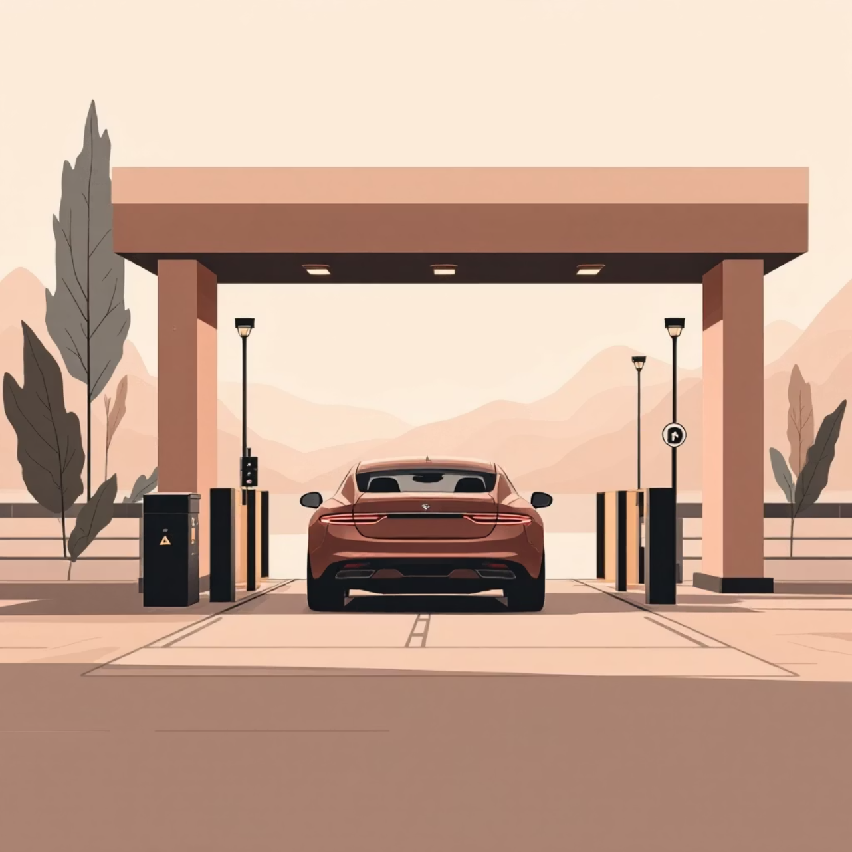
Removing a Vehicle
You just type in the vehicle number.
The program finds it among all the parked vehicles.
If found, it says goodbye to the vehicle and shows the final charge.
If not, it politely tells you "Vehicle not found."

Slide 8
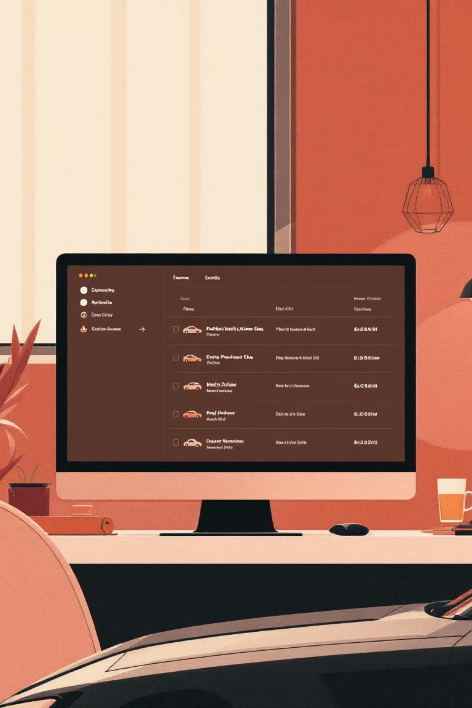
Displaying All Parked Vehicles
Want to see who's in the lot? Our system shows:
Slot Number: Where it's parked.
Vehicle Details: Number, type, and hours.
Charge: How much is owed.
Makes keeping track super simple!

Slide 9





How the Program Runs
It's like an easy menu for parking management:
Available Slots
Park Vehicle
Remove Vehicle
All Parked
Exit
Just pick a number, and the program does the rest! You can keep going until you choose to exit.

Slide 10
Conclusion: Why This System is Useful
1
2
3
Simple Management
Clear Slots
Auto-Calculated Fees
Great for small parking areas.
No more confusion about empty spots.
No need to manually figure out charges.
4
5
Future Growth
Awesome Project
Can be expanded for bigger systems.
Perfect for beginners learning to code!

